Slide 2

Strategic Innovation Programme
A national mobilisation effort for strategic innovation in Sweden
Sustainable solutions for global challenges in today’s world
Increased international competitiveness

Slide 3

Broad collaboration
Collaboration between:
Businesses
Universities
Research institutes
Public-sector organisations

Slide 4
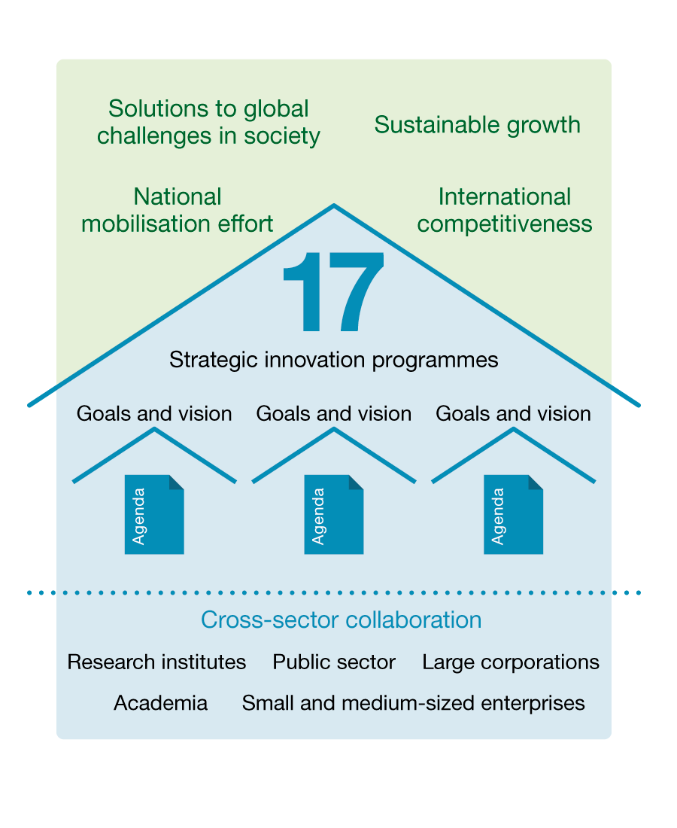
Background
The stakeholders in each programme have jointly developed an innovation agenda with visions and goals for specific areas.

Slide 5

17 strategic innovation programmes

Slide 6
What do the programmes do?
Calls for proposals
Market intelligence
Strategic initiatives
Conferences
Consultation
… and much more!

Slide 7
Public funding 2013–2029
8 billion

Slide 8
Total funding 2013–2029
16 billion

Slide 9
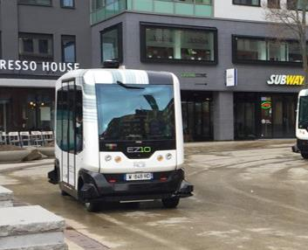





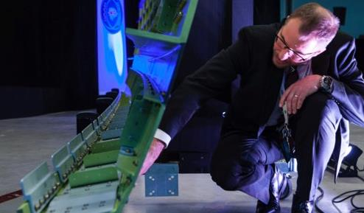

More than 1,200 projects
September 2018

Slide 10


Many participants
1,700 organisations

Slide 11
Ongoing evaluations
The programmes are evaluated every 3 years in order to:
Develop the programme format
Develop individual programmes
Decide on the programmes’ continued funding
Start
3 years
6 years
9 years
12 years
Leadership
Establishment of activities and initiatives specified in the impact logic
Leadership
Attractiveness
Outcome of ongoing activities and initiatives
Leadership
Attractiveness
Outcome of ongoing and completed activities and initiatives
Policy impact

Slide 12
Contact us
Peter Åslund
Vinnova Programme Management
peter.aslund@vinnova.se
Vilgot Claesson
Vinnova Programme Management
vilgot.claesson@vinnova.se

Slide 13


More information
vinnova.se/sip
Twitter: #sipnytt

