Slide 1
Future Press Release Ways of Persuading
QUICKGUIDE
Group Discussion
Objective
How do we want people to imagine the future change?
How have we incorporated the “voice of the customer” (and other system “actors”) in the press release as they see the future change?
In what ways does our story describe tangible outcomes?
Which parts of the change we imagine can happen today?
When we read our own press release, are we excited about committing to making this change real?
Which parts of our story make our colleagues curious to know more?
Would this press release surprise and delight readers outside our organization, and why?
Instructions
Discuss what our opportunity looks like in the future and at what time horizon (e.g., in 10 years).
Write the story as a media announcement to show what has succeeded, focusing on the outcomes. Do not worry about explaining how we solve everything – save those answers for a corresponding detailed FAQ.
Use the headline to summarize the big idea and a subheading to emphasize what has changed.
Highlight several quotes spoken by different representatives (e.g., city official, end user, citizen) relevant to our story, using their words to describe the change or benefit as they see it.
Optional: end with a call to action about how the readers can get involved in the next step or milestone.

Slide 2
All swedes now work part time at this agency
Since the beginning of this year every Swedish citizen have a new job to put on their CV, they are all hired to innovate their lives and communities for the better!
As of 2035 all swedes to part time with innovation activities on the new agency called “The Dream factory”. The organization now have the whole Swedish population as employees and is the world’s first governmental agency-based community. The concept is easy, every month citizen gets paid for solving problems in their daily life and community with creative concepts and everyone is part of the same agency platform.

Slide 3
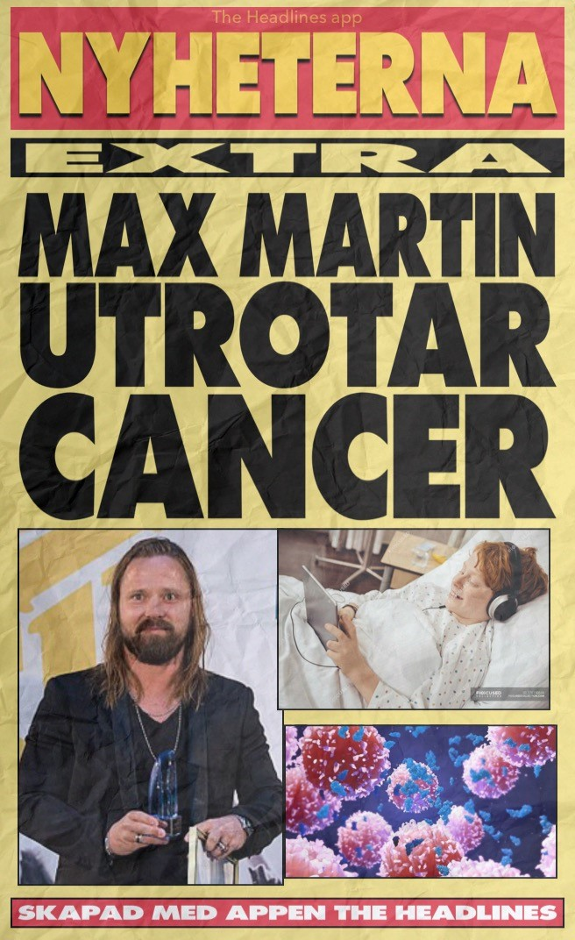
From Billboard producer to healer of cancer – Max Martin produces his biggest hit ever
The discovery of how targeted ultra-high audio frequencies embedded in individually designed music can be used to cure cancer has taken the renowned Swedish music producer into a completely new domain made possible through the Serendipity Challenge launched by Vinnova in 2022.
The Serendipity Challenge is a result of the explorative and experimental work done by Vinnova X – the Swedish Innovation Agency’s R&D department.
“Our perpetual quest reinventing how we approach the greatest challenges in society has a lot of “crash-and-burn” results, but when we get it right – we get it amazingly right” says Max Råsberg, Head Magician of Radical Ideas.

Slide 4
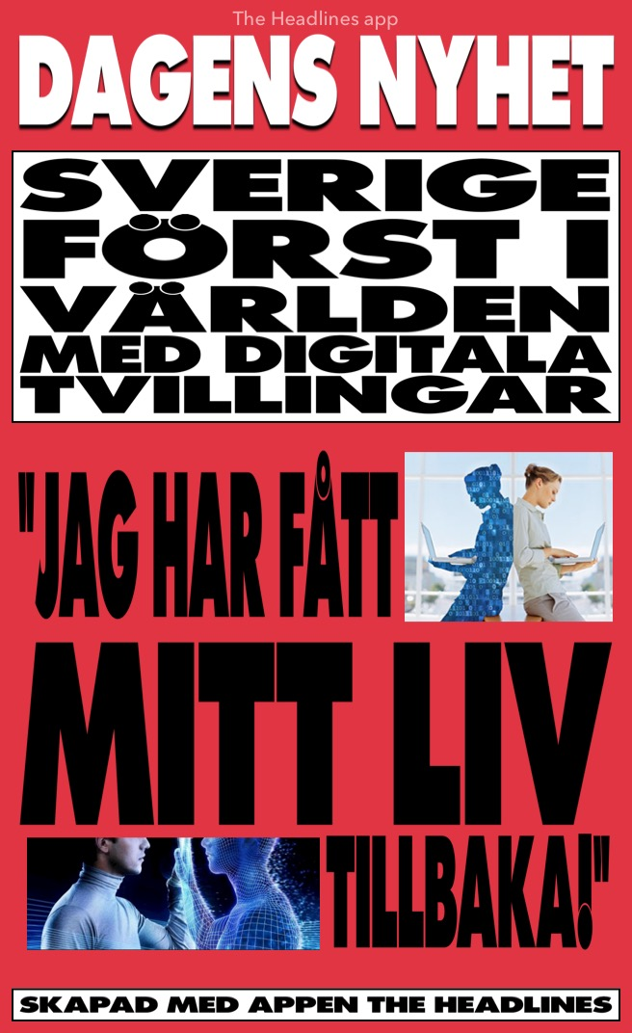
Digital Twins für alle!
Based on work done in industry on digital twins, Sweden has introduced digital twins for personal use. The digital transformation that companies have experienced with AI and automation is now moving into the private sphere.
The digital twin roadmap started when AI-bots got popular for managing one’s retirement savings. With twins, we expect citizens to be in better control of their own financial status, and substantial efficiency gains from a more adaptive market for private equity, says Inge Bill, Minister of Finance.
Personal digital twins are not limited to finance but also cover health aspects for you as an individual. The twin bots as based on the latest research in the area of health behaviorism. For most common diseases, preventive health measures have been shown to perform far better than pharma treatments.
The next step in the digital twin program in Sweden is providing the same twin bots solution for school children. In an increasingly complex society, everyone can benefit from better support to make life easier. This is also true for our young.

Slide 5
The stubborn nation, Sweden of the Nordics, again dares to do what it pleases – now introducing their own ‘e-krona’: A cash-less currency from it’s central bank.
Anna Kinberg Batra cites Vinnova’s Ylva Strander: ”It was quite a ride, to balance parties in private and public sectors, each with strong vested financial interests, while simultaneously moving project milestones forward”. “Here, mission-oriented designs from strategic team members such as Anja Melander became crucial”, according to Vinnova’s Ylva Strander.
If you are interested in the above and have great transformative ides for the future, never hesitate to contact Vinnova’s team Future Transformation Areas. ‘Yeah. They are so…awesome’, assures Sweden’s Greta Thunberg.

Slide 6
Future Press Release Ways of Persuading
QUICKGUIDE
Gruppdiskussion
Mål
How do we want people to imagine the future change?
How have we incorporated the “voice of the customer” (and other system “actors”) in the press release as they see the future change?
In what ways does our story describe tangible outcomes?
Which parts of the change we imagine can happen today?
When we read our own press release, are we excited about committing to making this change real?
Which parts of our story make our colleagues curious to know more?
Would this press release surprise and delight readers outside our organization, and why?
Instruktioner
Discuss what our opportunity looks like in the future and at what time horizon (e.g., in 10 years).
Write the story as a media announcement to show what has succeeded, focusing on the outcomes. Do not worry about explaining how we solve everything – save those answers for a corresponding detailed FAQ.
Use the headline to summarize the big idea and a subheading to emphasize what has changed.
Highlight several quotes spoken by different representatives (e.g., city official, end user, citizen) relevant to our story, using their words to describe the change or benefit as they see it.
Optional: end with a call to action about how the readers can get involved in the next step or milestone.

